Slide 2
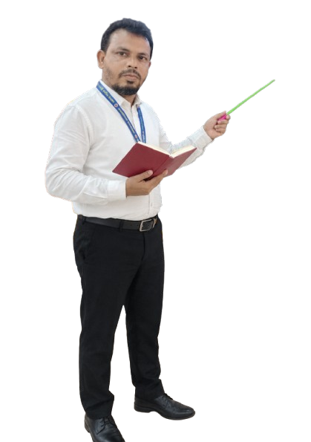

MD KOYES AHMED
Assistant Teacher
Mohammadpur A. Gofur GPS
Dakshin Surma, Sylhet.
E-mail: koyesdsurma.syl@gmail.com
Mobile: 01710504502.
Class: One
Sub: English for Today
Unit: 02
Lesson: 03
Title: Cc Dd
Activities: A, B
Period: 01
Page: 17

Slide 3
LISTENING:
1.1.1 recognize the sounds of the alphabet in familiar words .
1
SPEAKING:
3.1.1 say proper sounds of the letters in familiar words .
2
READING:
4.1.1 read the pictures of familiar objects and events.
3

Slide 4

Let’s sing.

Slide 5

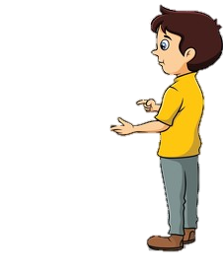
What did we learn yesterday ?
Aa
Bb

Slide 6
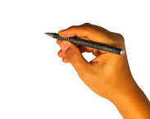
We are going to learn some English letters today ,
Cc,Dd

Slide 7
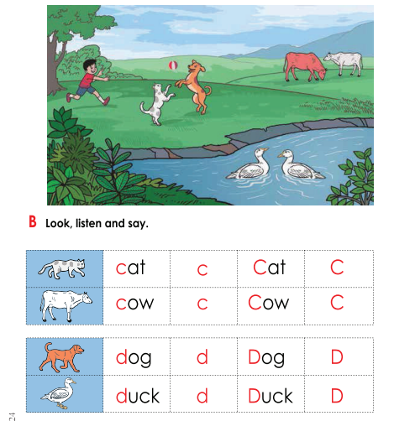
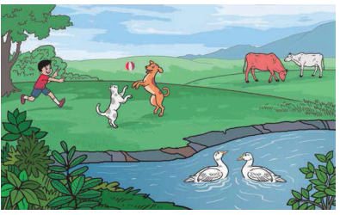
Open your book at page : 17
What can you see in the picture?

Slide 8
What can you see in the picture?
ball
boy
cow
duck
dog
cat

Slide 9
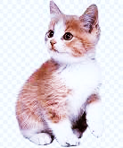
What’s this?
How do we say that in English?

Slide 10
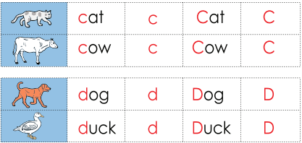
Listen to me and repeat after me
cat
c
Cat
C

Slide 11
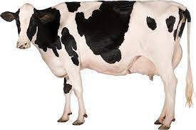
What’s this?
How do we say that in English?

Slide 12
Listen to me and repeat after me
cow
c
Cow
C

Slide 13
Listen to me and repeat after me
Small c
c
capital C
C

Slide 14
The letter name of C is /si/

Slide 15
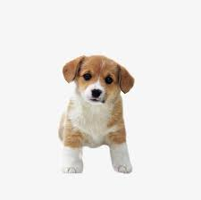
What’s this?
How do we say that in English?

Slide 16
Listen to me and repeat after me
dog
d
Dog
D

Slide 17
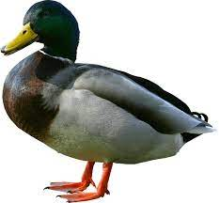
What’s this?
How do we say that in English?

Slide 18
Listen to me and repeat after me
duck
d
Duck
D

Slide 19
Listen to me and repeat after me
capital D
D
Small d
d

Slide 20
The letter name of D is
/di/

Slide 21




What’s this?
cat
duck
cow
dog

Slide 22
c
Say the sound of letter
d
/si/
C
/di/
D

Slide 23
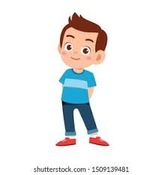
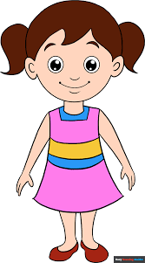
Group 1
Group 2
When I say the word(cat,cow,dog,duck)you will touch the picture. Whoever touches first get 1 Point
1+1+ | 1+1+
Group 1
Group 2
Let’s play touch the board.

Slide 24
d
Matching letter with picture.
c
Group 1
Group 2
d
c

Slide 25

Lets play a game (kims game).
Close your eyes
Open your eyes
Which word have I covered

Slide 26
What’s this?
dog
cat
cow
duck

Slide 27


Listen to the audio and round the correct letter.
g
f
k
h
/si/
e
c
d
m

Slide 28
Listen to the audio and round the correct letter.
g
f
k
h
/di/
e
b
c
d

Slide 29
d
cow
cat
duck
dog
c
d
Say the first letter ..
c

Slide 30
Draw and colour a cat.

