Slide 1

The 12 Months

Slide 2
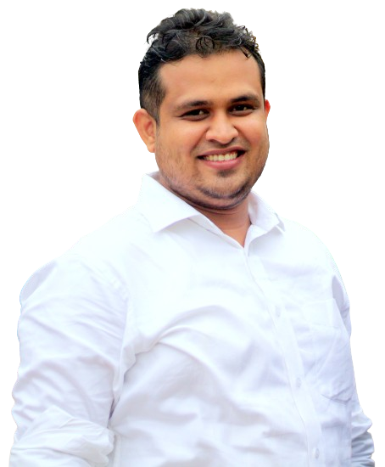

Uday Kumar Shil
Introduction
Assistant Teacher
Isladigor Uttar Para Government Primary School
Raiganj, Sirajganj
+880 1717 154 727

Slide 3
January
February
March
April
May
June
July
August
September
October
November
December

Slide 4

1
January

Slide 5
2
February

Slide 6
3
March

Slide 7
4
April

Slide 8
5
May

Slide 9
6
June

Slide 10
7
July

Slide 11
8
August

Slide 12
9
September

Slide 13
10
October

Slide 14
11
November

Slide 15
12
December

Slide 16
Thank You

