Slide 2


MD KOYES AHMED
Assistant Teacher
Mohammadpur A. Gofur GPS
Dakshin Surma, Sylhet.
E-mail: koyesdsurma.syl@gmail.com
Mobile: 01710504502.
Lesson Plan
Class: 3
Subject: English
Unit: 1
Lesson: 4 Goodbye 1
Page: 8,9
Time: 45

Slide 3
Understanding simple dialogues about day-to-day activities for effective communication.
Exchanging greetings and farewells at different times for effective communication.

Slide 4

Lets sing a song

Slide 5
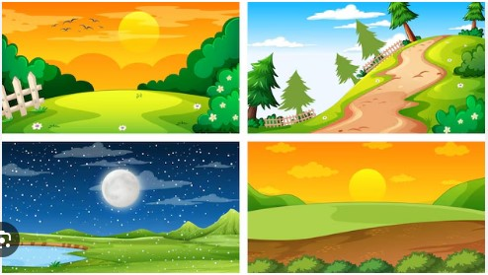
Review of prior knowledge
What do you say in the ……. To greet someone in English?

Slide 6

Today’s Lesson
Goodbye 1

Slide 7

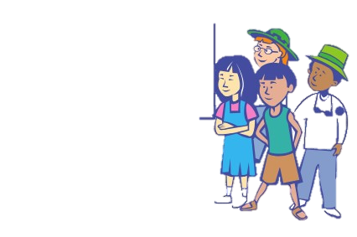
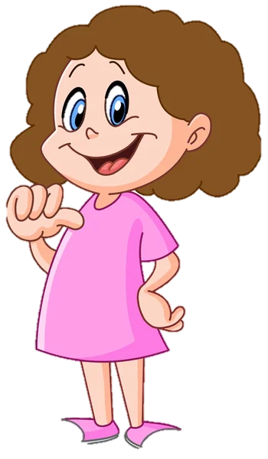

Who are they?
Who is she?
Who am i?

Slide 8
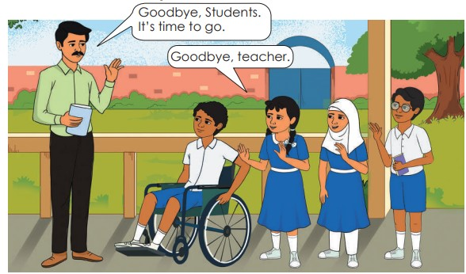

Slide 9
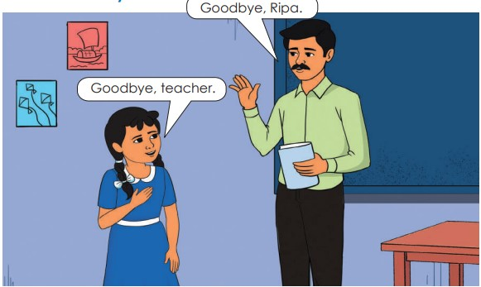

Slide 10
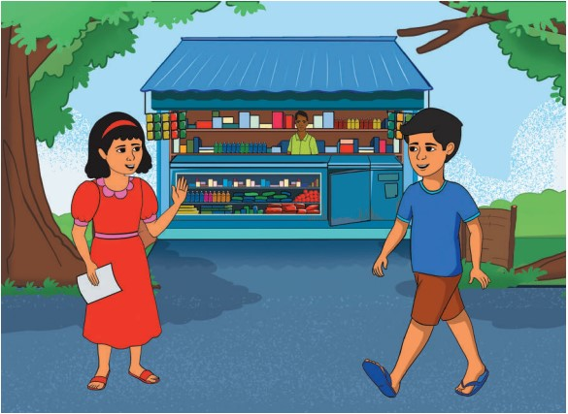

Slide 11
Act out the dialogue with your friend
Rahat: Hello Namira, how are you?
Namira: I’m fine, thanks. And you?
Rahat: I’m good. Where are you going?
Namira: I’m going to buy some medicines.
Rahat: Okay, goodbye. See you later.
Namira: Goodbye!

Slide 12
Rearrange the words in correct order
to make meaning sentences
1. Are / you/ how?
2. Are / where / going/ you?
3. Meet / to/ you/ nice.
4. Later/ you/ see.
5. hello/ Rahat/ saying/ greets/ Namira.
1. How are you?
2. Where are you going?
3. Nice to meet you.
4. See you later.
5. Rahat greets Namira saying hello.

Slide 13
Rewrite the sentences using capital letters and punctuation marks where necessary
Namira: im fine thanks and you
Rahat: im good where are you going
Namira: I’m fine, thanks. And you?
Rahat: I’m good. Where are you going?

Slide 14


Put tick (∙) mark to the correct answer.
Here ‘drug’ means
a) medicine
b) fruit
Here ‘friend’ means
a) companion
b) brother
Here ‘nice’ means
a) dislike
b) fine
For greeting we say
a) Good bye
b) Hello
For farewell we say
a) Goodbye
b) Hi

Slide 15
Match the words in column A with column B
Column A | Column B
Goodbye | After a while
Later | A drug for treatment
Buy | Purchase
Some | Farewell
Medicine | A few

Slide 16
Write the question words from the box to complete the question setences.
Where
What’s
Who
How
Namira going to buy ?
is Rahat ?
is Rahat going ?
is going to pharmacy ?
does teacher say ?

