Slide 1
Primary English With Anisur Rahman
Cover
📚 Class 2 English
Unit 7: Colours, Shapes and Signs
Lesson 3: Shapes and Sizes
Pages 67–68
📚 English With Anisur Rahman | Learn English with Bangla Explanation

Slide 2
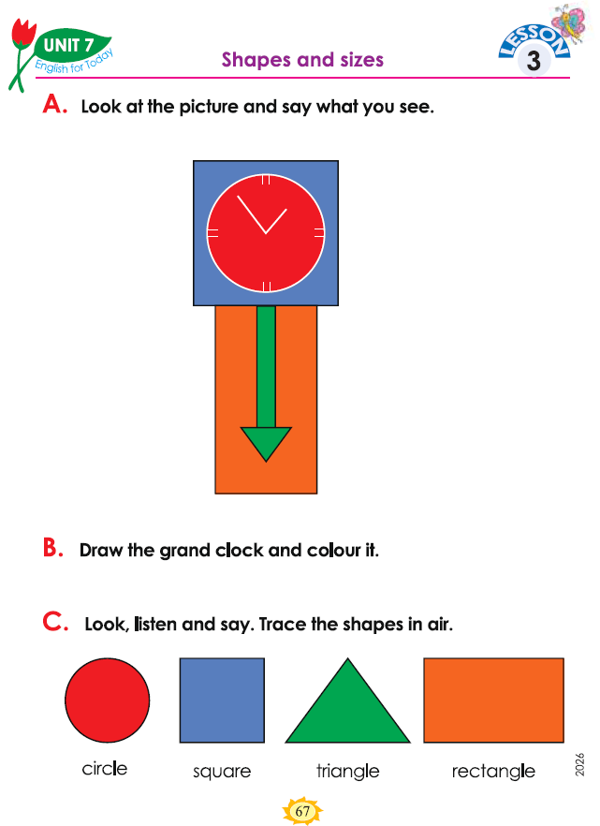
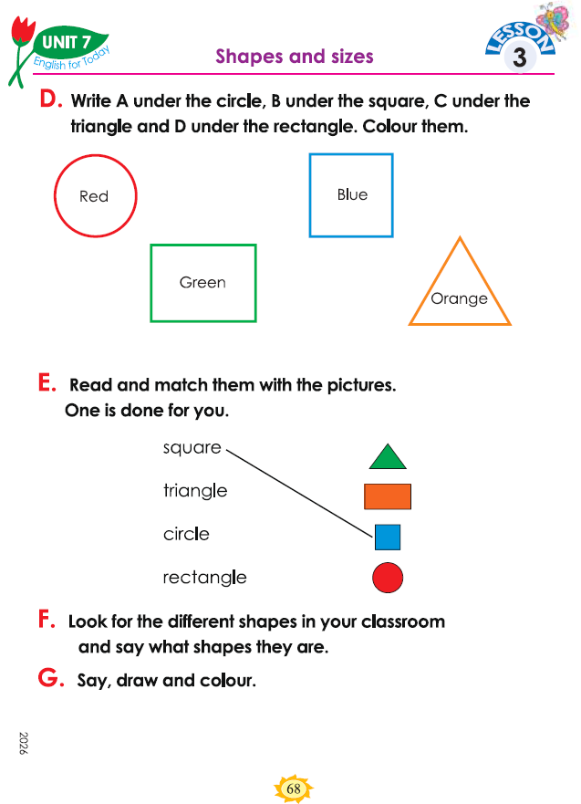
Primary English With Anisur Rahman
Cover
📚 Class 2 English
Unit 7:
Colours, Shapes and Signs
Lesson 3: Shapes and Sizes
Pages 67–68
📚 English With Anisur Rahman | Learn English with Bangla Explanation

Slide 3
Primary English With Anisur Rahman
🎯 Learning Outcomes
By the end of the lesson, students will be able to:
identify four basic shapes;
say the names of the shapes in English;
identify shapes in classroom objects;
match shapes with their names;
draw and colour simple shapes.
📚 English With Anisur Rahman | Learn English with Bangla Explanation

Slide 4
Primary English With Anisur Rahman
Warm-up
📚 English With Anisur Rahman | Learn English with Bangla Explanation

Slide 5
Primary English With Anisur Rahman
Revision
📚 English With Anisur Rahman | Learn English with Bangla Explanation

Slide 6
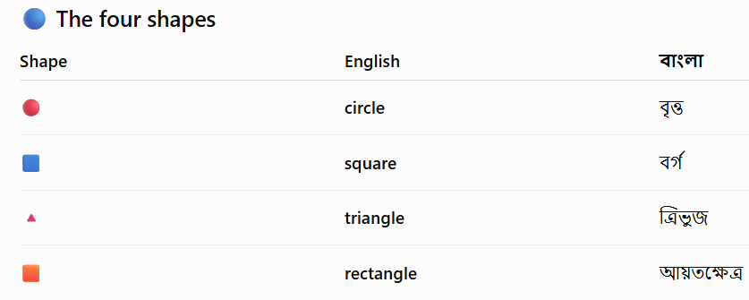
Primary English With Anisur Rahman
Vocabulary
▭
📚 English With Anisur Rahman | Learn English with Bangla Explanation

Slide 7
Primary English With Anisur Rahman
Activity A
What do you see?
Sample answers:
I see a clock.
I see a circle.
I see a square.
I see a rectangle.
I see an arrow.
📚 English With Anisur Rahman | Learn English with Bangla Explanation

Slide 8
Primary English With Anisur Rahman
Activity A
👨‍🏫 Teacher Practice
Teacher: What is this?
Students: It is a clock.
Teacher: What shape is the clock?
Students: It is a circle.
Continue...
📚 English With Anisur Rahman | Learn English with Bangla Explanation

Slide 9
Primary English With Anisur Rahman
Activity B
Step 1: Draw a circle. ⭕
Step 2: Draw the clock hands. 🕐
Step 3: Add numbers if you like.
Step 4: Colour your clock.
📚 English With Anisur Rahman | Learn English with Bangla Explanation

Slide 10
Primary English With Anisur Rahman
Activity C
📚 English With Anisur Rahman | Learn English with Bangla Explanation
Notes:
For Class 2, don't spend too much time on pronunciation symbols. Focus on listen → repeat → recognize.

Slide 11
Primary English With Anisur Rahman
Activity D
A
B
D
C
📚 English With Anisur Rahman | Learn English with Bangla Explanation
Notes:
For Class 2, don't spend too much time on pronunciation symbols. Focus on listen → repeat → recognize.

Slide 12
Primary English With Anisur Rahman
Activity E
📚 English With Anisur Rahman | Learn English with Bangla Explanation
Notes:
For Class 2, don't spend too much time on pronunciation symbols. Focus on listen → repeat → recognize.

Slide 13
Primary English With Anisur Rahman
Activity F
Examples:
🕐 Clock
Window
→
Rectangle
→
Circle
Window
→
Rectangle
📖 Book
→
Rectangle
🚪 Door
→
Rectangle
📚 English With Anisur Rahman | Learn English with Bangla Explanation
Notes:
For Class 2, don't spend too much time on pronunciation symbols. Focus on listen → repeat → recognize.

Slide 14
Primary English With Anisur Rahman
Activity F
What shape is the clock?
It is a circle.
What shape is the window?
It is a rectangle.
What shape is the tile?
It is a square.
📚 English With Anisur Rahman | Learn English with Bangla Explanation

Slide 15
Primary English With Anisur Rahman
Activity F
Say the name of a shape.
Draw it.
Colour it.
For example:
This is a triangle.
I draw a triangle.
I colour it green.
For example:
This is a circle.
I draw a circle.
I colour it red.
📚 English With Anisur Rahman | Learn English with Bangla Explanation

Slide 16
Primary English With Anisur Rahman
Activity G
Say the name of a shape.
Draw it.
Colour it.
For example:
This is a circle.
I draw a circle.
I colour it red.
📚 English With Anisur Rahman | Learn English with Bangla Explanation

Slide 17
Primary English With Anisur Rahman
Pair Work
⭕
What shape is it?
It is a circle.
🔺
What shape is it?
It is a triangle.
📚 English With Anisur Rahman | Learn English with Bangla Explanation

Slide 18
Primary English With Anisur Rahman
Pair Work
▭
What shape is it?
It is a rectangle.
📚 English With Anisur Rahman | Learn English with Bangla Explanation

Slide 19
Primary English With Anisur Rahman
Practice
Fill in the blanks.
A clock is a __________.
A door is a __________.
A shape with three sides is a __________.
A shape with four equal sides is a __________.
circle
rectangle
triangle
square
📚 English With Anisur Rahman | Learn English with Bangla Explanation

Slide 20
Primary English With Anisur Rahman
Quiz
1. What shape is a clock?
✅ Circle
2. What shape is a door?
✅ Rectangle
3. What shape has three sides?
✅ Triangle
📚 English With Anisur Rahman | Learn English with Bangla Explanation

Slide 21
Primary English With Anisur Rahman
Quiz
4. What shape has four equal sides?
✅ Square
5. How many basic shapes did we learn today?
✅ Four
📚 English With Anisur Rahman | Learn English with Bangla Explanation

Slide 22
Primary English With Anisur Rahman
Assessment
📚 English With Anisur Rahman | Learn English with Bangla Explanation

Slide 23
Primary English With Anisur Rahman
Homework
Draw and colour these four shapes:
⭕ Circle
Square
🔺 Triangle
▭ Rectangle
Then write their names underneath.
📚 English With Anisur Rahman | Learn English with Bangla Explanation

Slide 24
Primary English With Anisur Rahman
Thank You
📚 English With Anisur Rahman | Learn English with Bangla Explanation

