Slide 1


Slide 2

WELCOME

Slide 3
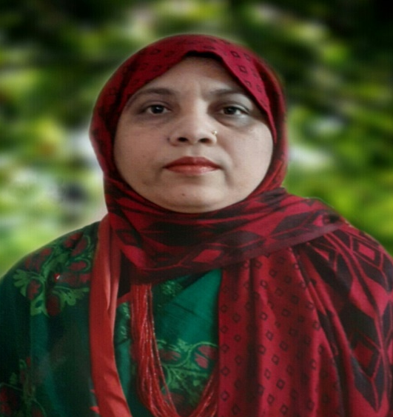
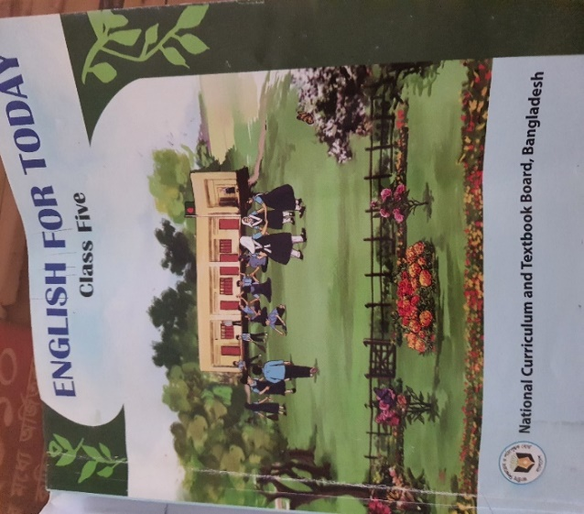

IDENTITY
Muktamony
Head teacher
Atashia Government Primary School
Shibpur , Narsingdi.
Title –The Champion Girl
Class - Five
Subject- English
Unit-14 , Page -74
Lesson- 1, (1.2 L[pi –clearly.)
Time-40 minutes
Date---/08/2026

Slide 4
Learning Outcomes
Learning Outcomes:
3.4.1 Ask simple questions on familiar topics.
3.4.2 Answer simple questions appropriately and confidently.
4.2.1 Read aloud texts with proper stress, intonation.

Slide 5
Review of the prior knowledge:
Have you ever played a game with your eyes closed ?
How do you feel when you close your eyes ?
Can you do your daily activies with your eyes closed ?

Slide 6
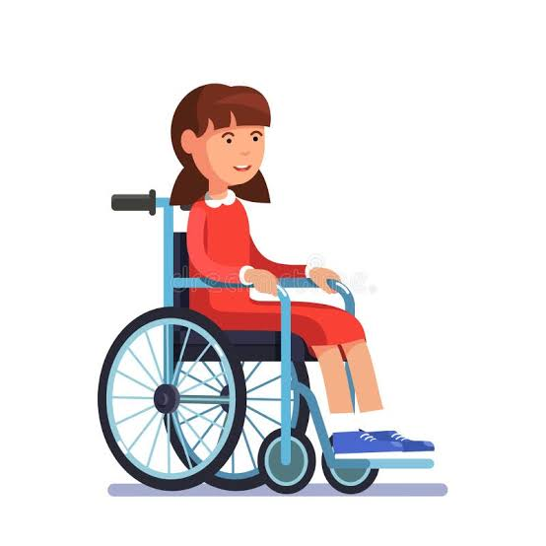
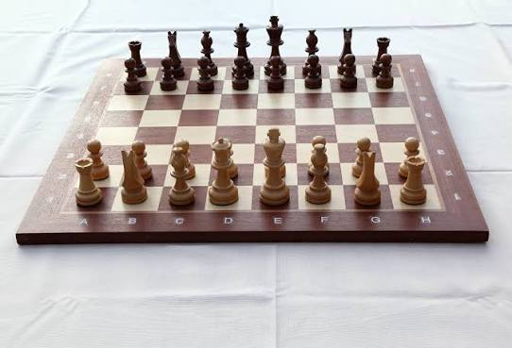
Look at the pictures. The girl won the chess competition. Which name do you want to call her ?

Slide 7
Our today’s topic’s--
The Champion Girl

Slide 8
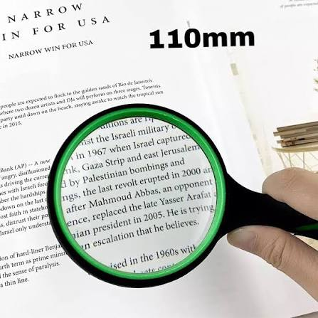
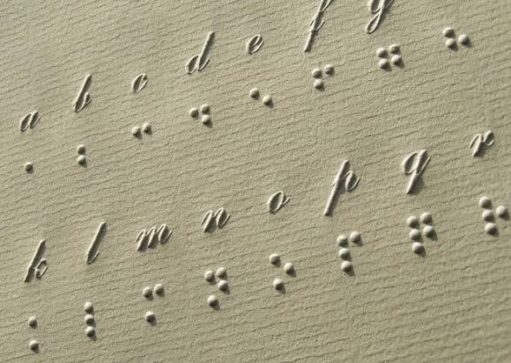
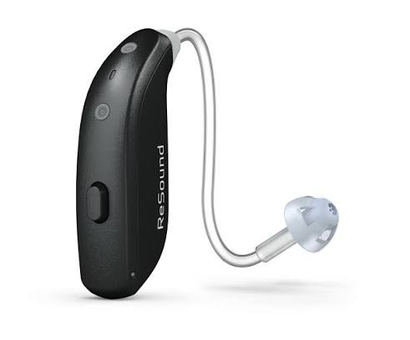
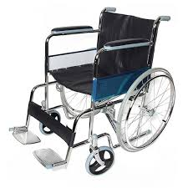
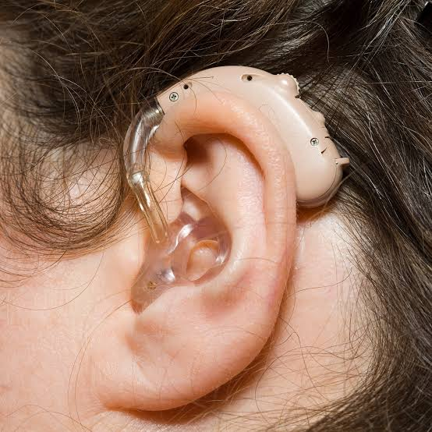
Look at the pictures. Discuss in your pairs . Have you seen these things before ?

Slide 9
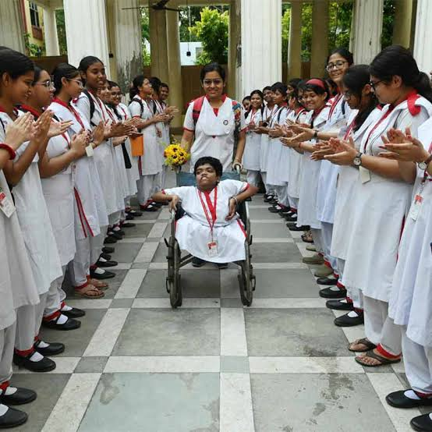
She is a lot like any other girls in her neighbourhood . Lipi can not walk like her friends . Instead, she uses a wheelchair to move.

Slide 10
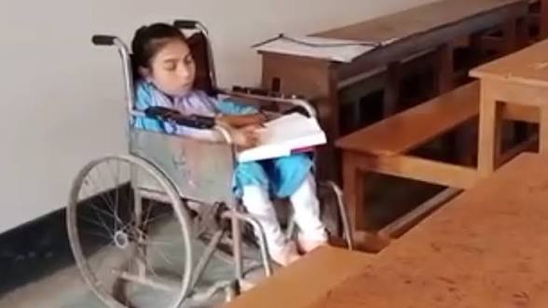
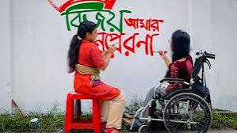
q

Slide 11
Have you seen these things before ?
Yes, I have seen these things before.
b. Do you know anyone who uses any of them ?
Answer: Yes, I know one of my neighbours uses a wheelchair.
c. Why do people use these things ?
Answer: People use these things when they are physically challenged.

Slide 12
Nearby-নিকটে- not far away
Study- লেখাপড়া করা—read/learn
Bright- উজ্জ্বল- shiny
Smile-হাসি- a pleased ,kind or amused facial expression
Neighbourhood-পাড়া/এলাকা - locality
Wheelchair- হুইল চেয়ার- a chair with wheels
Classmate- সহপাঠী -people reading in same class
Comfortable- আরামদায়ক- pleasant
Clearly-স্পষ্টভাবে- in a way that is easy to see or hear
Favorite-প্রিয়- a person or things liked by all

Slide 13
One day one word
Neighbourhood-পাড়া/ মহল্লা
Salma lives in our neighbourhood .

Slide 14
a. How does Lipi get ready for school every morning ?
Answer: Everyday Lipi gets up early ,gets dressed and takes her breakfast. Thus, Lipi gets ready for school every morning.
b. How does Lipi get to her seat in the class ?
Answer: Lipi’s classmates helps her to sit at the front bench of the class.
c. What competition has Lipi won at school ?
Answer: Lipi won chess competition at school.
d. How did Lipi feel after winning the competition ?
Answer: After winning the competition Lipi felt very cheerful and excited.
e. Why does Lipi want to become a teacher ?
Answer: Lipi wants to become a teacher because Ms. Anita, her class teacher is her inspiration.

Slide 15

Choose the best Answer
a. Lipi lives -------- her grandparents ina small village.
Besides ii. In iii. With iv. At
b. How does Lipi talk?
Angrily ii. Wrongly iii. nicely iv. Quickly
c. What does Lipi use for movement?
A car ii. A bicycle iii. A wheel chair
iv. A motorbike
d. When does Lipi get up in the morning?
Early ii. Late iii. Quickly iv. Gradually
e. Lipi’s classmates -----------her to sit at the front bench.
Discourage ii. Inspire iii. Assist iv. Ignore
f. Why does the teacher aarrange Lipi’s table ?
To see the blackboard clearly ii. To understand the lesson
to hear the speech clearly iv. To learn easily

Slide 16
Fill in the gaps . ( local/sit /comfort / dreams/listening/teacher)
i. Lipi’s classmates help her to -----------------at the front bench.
ii. She has a heart full of ---------------------------- .
iii. Ms. Anita makes sure Lipi’s -------------------- in the class.
iv. Lipi loves -------------------------- stories.
v. Lipi wants to be a ----------------------------- .
sit
dreams
comfort
listening
teacher

Slide 17
3.1 Language Focus: Want to be-
I want to be a teacher.
He wants to be a doctor.
She wants to be a painter.
Saki wants to be a police .
Liana wants to be a pilot .
Toha wants to be a nurse .

Slide 18
Group work
Group - Chess
Group - Football
Find out five new words from the story. Make sentences.
Find out five new words from the story . Make sentences.

Slide 19

Home Work
Write at least five sentences about the champion girl.

Slide 20

GOODBYE

