Slide 1
Primary English With Anisur Rahman
Cover
Class 2 English
Unit 7: Colours, Shapes and Signs
Lesson 2: Rainbow
Pages 65–66
📚 English With Anisur Rahman | Learn English with Bangla Explanation

Slide 2
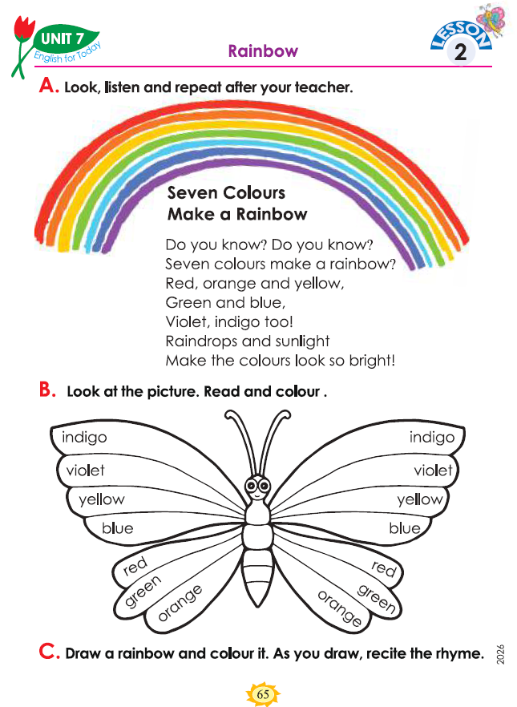
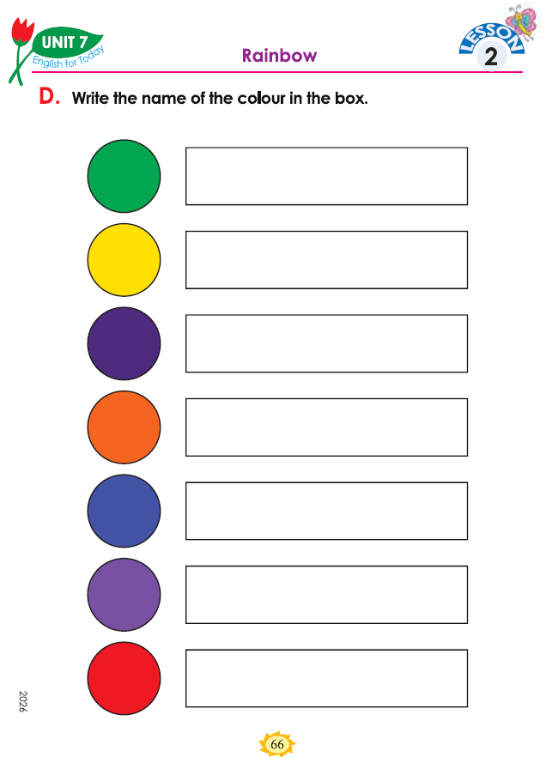
Primary English With Anisur Rahman
Cover
📚 Class 2 English
Unit 7
Lesson 2: Rainbow
Pages: 65–66
📚 English With Anisur Rahman | Learn English with Bangla Explanation

Slide 3
Primary English With Anisur Rahman
🎯 Learning Outcomes
By the end of the lesson, students will be able to:
  name the seven colours of a rainbow;
  recite the rhyme “Seven Colours Make a Rainbow”;
  identify and colour the seven colours;
  write the names of colours;
  recognize the sequence of rainbow colours.
📚 English With Anisur Rahman | Learn English with Bangla Explanation

Slide 4
Primary English With Anisur Rahman
Warm-up
Have you ever seen a rainbow?
Sample answer:
Yes, I have.
📚 English With Anisur Rahman | Learn English with Bangla Explanation

Slide 5
Primary English With Anisur Rahman
Revision
🌈 Let's revise the seven colours!
Red → Orange → Yellow → Green → Blue → Violet → Indigo
📚 English With Anisur Rahman | Learn English with Bangla Explanation

Slide 6
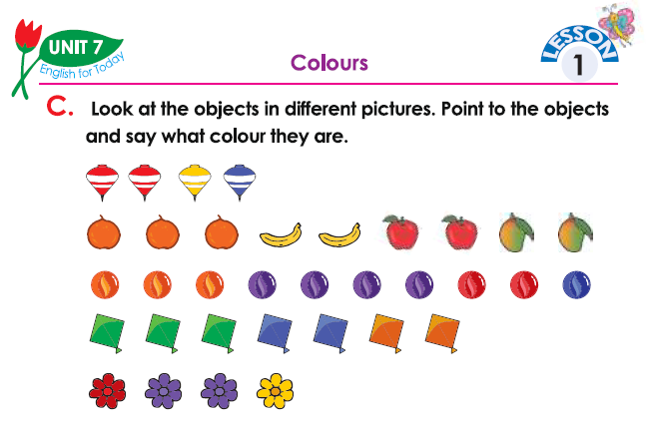
Primary English With Anisur Rahman
Activity C
yellow.👉
blue.👉
red. 👉
yellow.👉
red. 👉
green.👉
orange. 👉
violet.👉
red. 👉
blue. 👉
orange.👉
indigo.👉
orange. 👉
green. 👉
violet.👉
yellow. 👉
red.👉
📚 English With Anisur Rahman | Learn English with Bangla Explanation

Slide 7
Primary English With Anisur Rahman
Vocabulary
Rainbow = রংধনু
📚 English With Anisur Rahman | Learn English with Bangla Explanation

Slide 8
Primary English With Anisur Rahman
Activity A
Let's Recite:
📚 English With Anisur Rahman | Learn English with Bangla Explanation

Slide 9
Primary English With Anisur Rahman
Activity A
Do you know? Do you know?
তুমি কি জানো? তুমি কি জানো?
Seven colours make a rainbow?
সাতটি রঙ মিলে রংধনু হয়?
Red, orange and yellow
লাল, কমলা ও হলুদ।
📚 English With Anisur Rahman | Learn English with Bangla Explanation

Slide 10
Primary English With Anisur Rahman
Activity A
Green and blue
সবুজ ও নীল।
Violet, indigo too!
বেগুনি ও ইন্ডিগোও!
📚 English With Anisur Rahman | Learn English with Bangla Explanation

Slide 11
Primary English With Anisur Rahman
Activity A
Raindrops and sunlight make the colours look so bright!
বৃষ্টির ফোঁটা ও সূর্যের আলো রংগুলোকে উজ্জ্বল করে তোলে।
📚 English With Anisur Rahman | Learn English with Bangla Explanation

Slide 12
Primary English With Anisur Rahman
Activity B
📚 English With Anisur Rahman | Learn English with Bangla Explanation

Slide 13
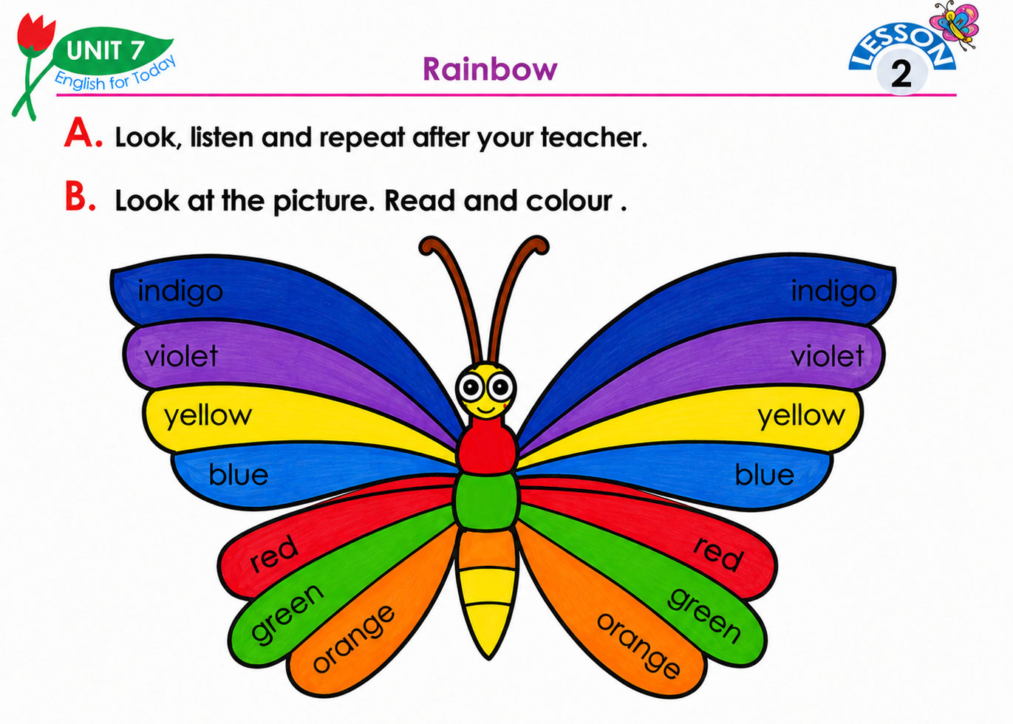
Primary English With Anisur Rahman
Activity B
📚 English With Anisur Rahman | Learn English with Bangla Explanation

Slide 14
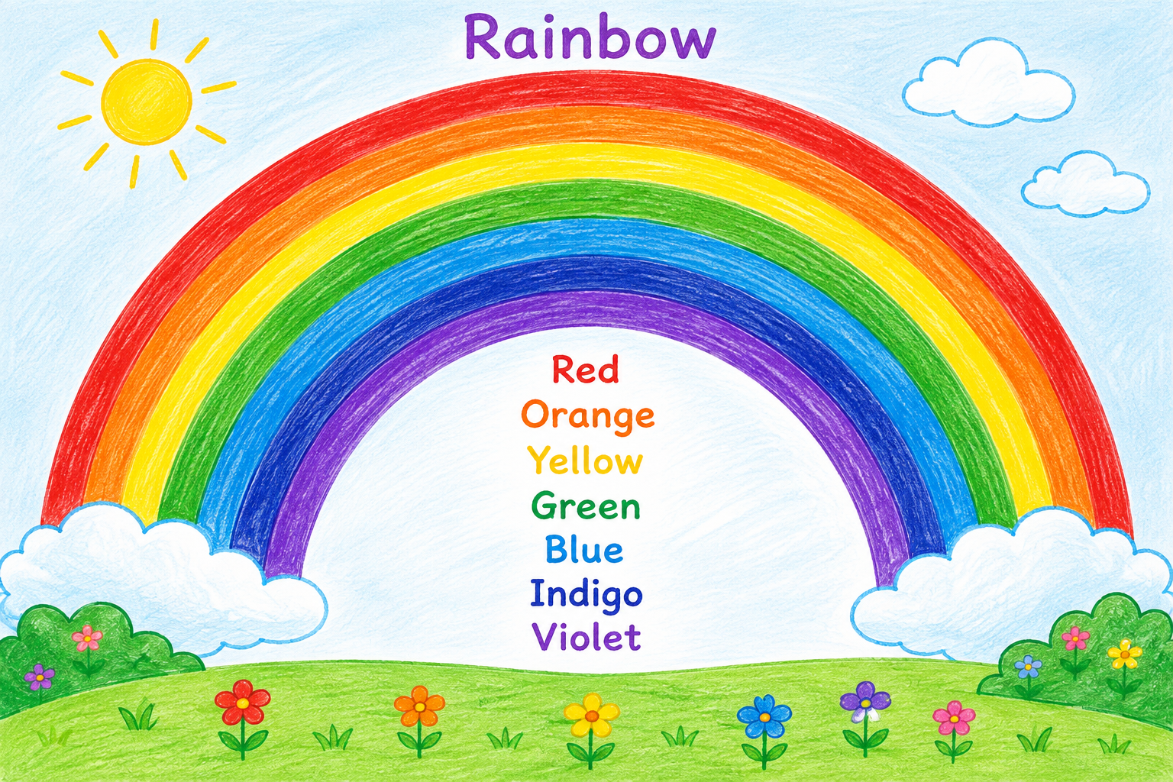
Primary English With Anisur Rahman
Activity C
📚 English With Anisur Rahman | Learn English with Bangla Explanation

Slide 15
Primary English With Anisur Rahman
Activity D
Green
Yellow
Indigo
Orange
Blue
Violet
Red
📚 English With Anisur Rahman | Learn English with Bangla Explanation

Slide 16
Primary English With Anisur Rahman
Pair Work
📚 English With Anisur Rahman | Learn English with Bangla Explanation

Slide 17
Primary English With Anisur Rahman
Practice
📚 English With Anisur Rahman | Learn English with Bangla Explanation

Slide 18
Primary English With Anisur Rahman
Quiz
How many colours make a rainbow?
Seven.
What colour comes after red?
Orange.
What colour comes after orange?
Yellow.
📚 English With Anisur Rahman | Learn English with Bangla Explanation

Slide 19
Primary English With Anisur Rahman
Quiz
What colour comes after yellow?
Green.
What colour comes after blue?
Indigo.
What is the last colour?
Violet.
📚 English With Anisur Rahman | Learn English with Bangla Explanation

Slide 20
Primary English With Anisur Rahman
Assessment
📚 English With Anisur Rahman | Learn English with Bangla Explanation

Slide 21
Primary English With Anisur Rahman
Homework
Draw a rainbow and colour it.
Then write the seven colours:
Red
Orange
Yellow
Green
Blue
Violet
Indigo
📚 English With Anisur Rahman | Learn English with Bangla Explanation

Slide 22
Primary English With Anisur Rahman
Thank You
Thank You
Wish you all the best.
📚 English With Anisur Rahman | Learn English with Bangla Explanation

