Slide 1
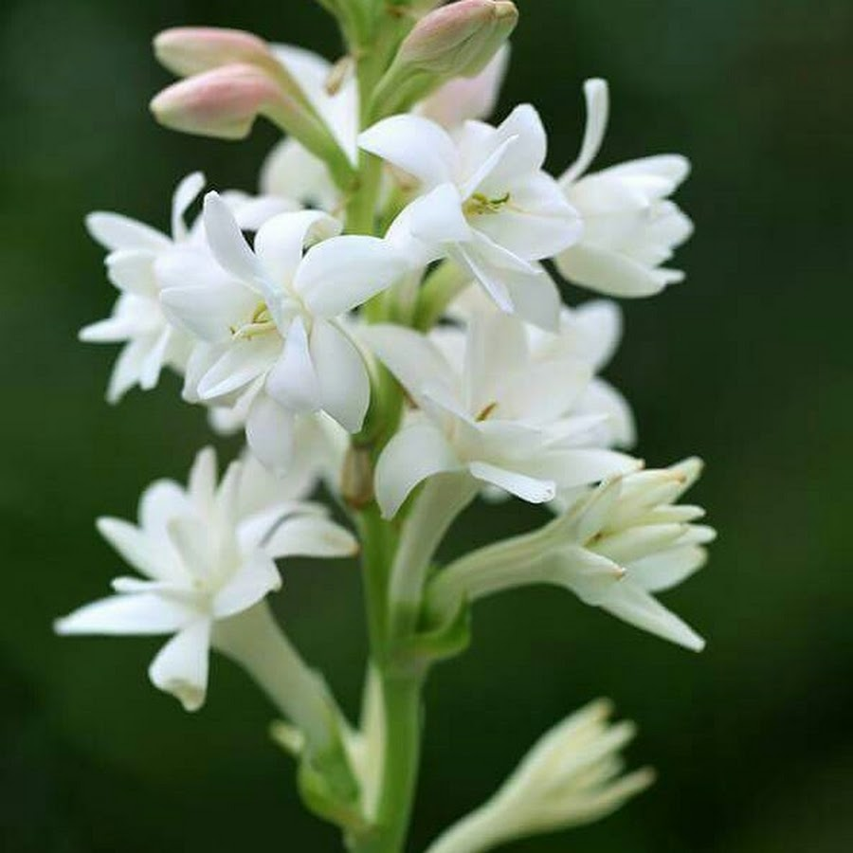
Welcome !

Slide 2

Teacher’s Introduction
Lesson’s Introduction
Topic: Isomerism
Class Level: HSC
Subject: Chemistry 2nd Paper
Chapter : 2
Chapter Title: Organic Chemistry
Md. Shoaib Ahmed
B.Sc (Honours), M.Sc.(Chemistry) from SUST,
PGD in IT from IICT, SUST
BEd from Bangladesh Open University
Chemistry Teacher
The Sylhet Khajanchibari International School & College
Email: shoaibchemistrysust@gmail.com

Slide 3
Learning objectives
After this lesson, learners will be able to:-
1. define isomerism
2. identify the types of isomerism
3. explain the different types of isomerism

Slide 4


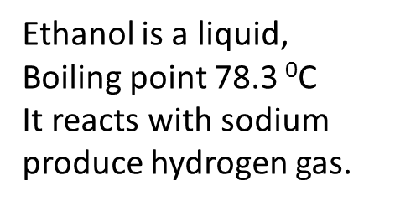
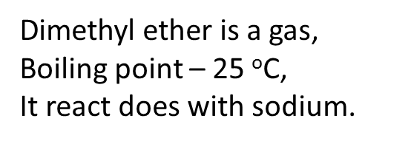
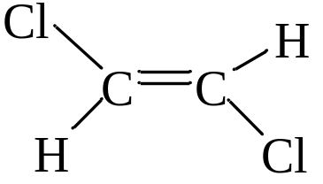
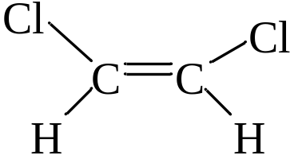
E-isomer
Z-isomer
N.B. Here, E (Entgegen) is a German word, means opposite sides and Z (Zusammen) means together(same side)

Slide 5
What is Isomerism?
Organic compounds that have the same molecular formula but differ in structural formula, have different modes of combination or arrangement of atoms within the molecules, and differ from each other in physical or chemical properties are called isomers. The phenomenon is called isomerism.

Slide 6
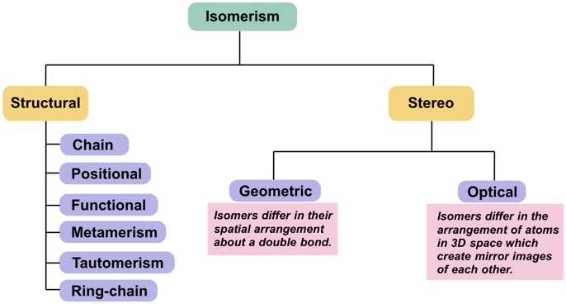

Slide 7
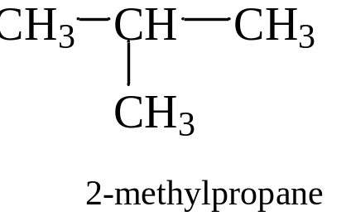
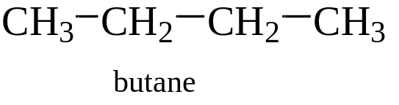


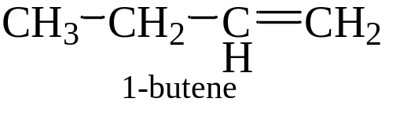
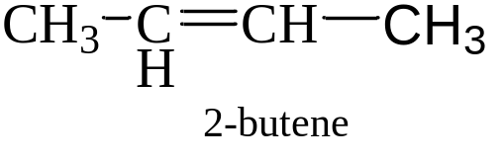
a. Structural Isomerism
1. Chain isomerism: Chain isomers have the same molecular formula but differ in their carbon chains.
2. Functional isomerism: Functional group isomers have the same molecular formula but different functional groups.
3. Position isomerism: Position isomers have the same molecular formula but differ in the position of a functional group or of double bond or triple bonds on the carbon chain.

Slide 8
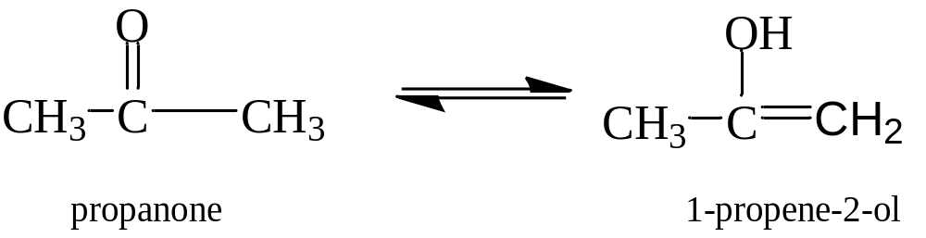
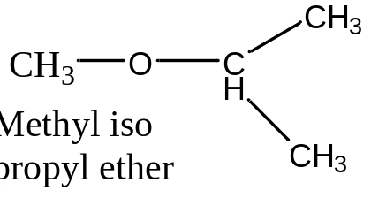
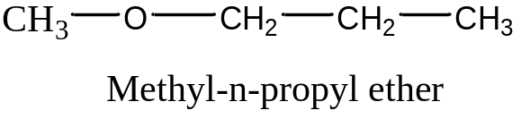
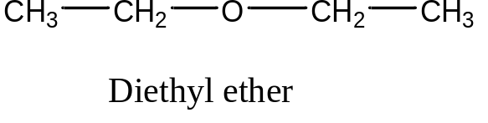
4. Tautomerism: It is a special type of functional group isomerism in which the isomers are in dynamic equilibrium with each other. In this type of isomerism compound with a functional group is converted to another functional group compound. The compounds are tautomers.
5. Metamerism: This type of isomerism is due to the unequal distribution of carbon atoms on either side of the functional group.

Slide 9
b. StereoIsomerism
The isomerism that is called by the different arrangements of atoms or groups in space is called stereoisomerism. The stereoisomers have same structural formulae but differ in the spatial arrangements of atoms or groups in the molecules i.e. differ in configurations.
Stereoisomerism is of two types:
Geometrical or cis-trans isomerism
Optical isomerism

Slide 10
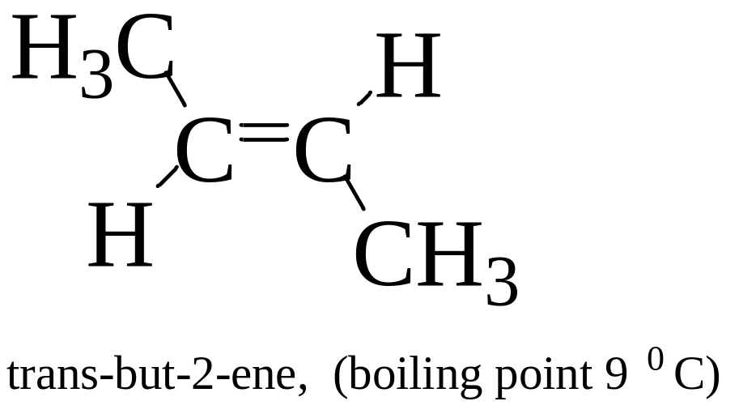
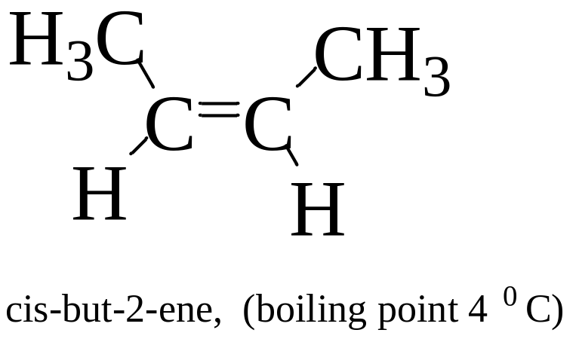
Geometrical or cis-trans isomerism
The type of isomerism in which the compounds have same structural formulae but there is difference in their relative arrangement of atoms or groups in space around the carbon-carbon double bond is called geometrical or cis-trans isomerism and the compounds are called geometrical isomers.

Slide 11
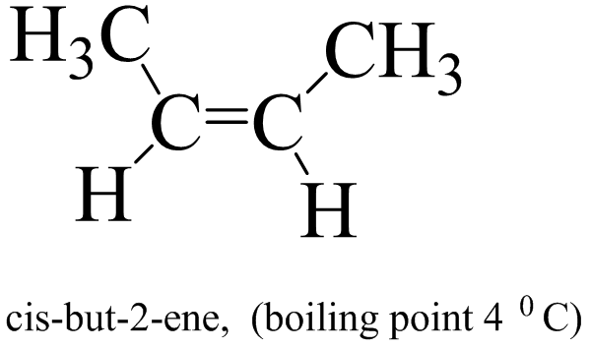
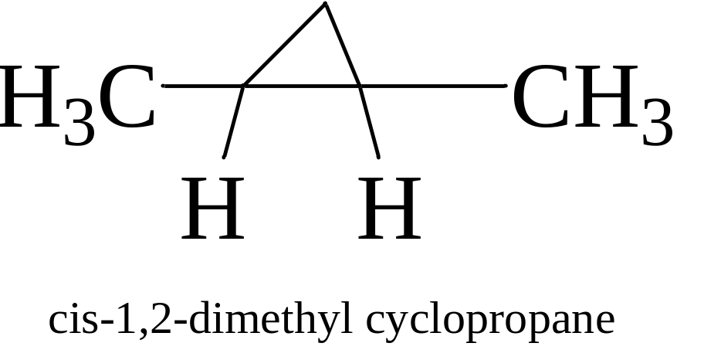
Conditions for geometrical isomerism
1. Substituted alkene
2. Substituted cyclic alkene

Slide 12
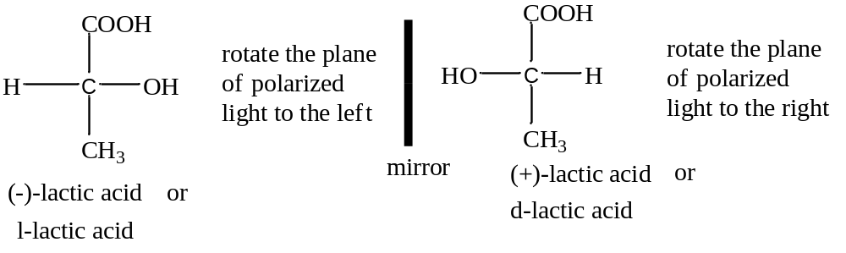
Optical isomerism
The type of isomerism in which two more possible isomers with molecular formula, structural formula and same physical and chemical properties but differ by their action on plane-polarized light to rotate the plane of polarized light in different degrees, is called optical isomerism then the obtained isomers are called optical isomers. For example-

Slide 13
Characteristics of optical isomerism
1. Optical isomers have asymmetric carbon atom or chiral center.
2. Both the optical isomers give mirror image of each other.
3. Optical isomers are not superimposable.

Slide 14
Evaluation
1. What is isomerism?
2. How many types of isomerism mainly?
3. What is functional isomerism?
4. What are the conditions for optical isomerism?

Slide 15
Thank you for joining the class.

