Slide 1
Primary English With Anisur Rahman
Cover
Class 2 English
Unit 7 – Colours, Shapes and Signs
Lesson 1 | Page 64
👨‍🏫 Teacher: Anisur Rahman
📚 English With Anisur Rahman | Learn English with Bangla Explanation

Slide 2
Primary English With Anisur Rahman
Learning Outcomes
At the end of the lesson, students will be able to:
Identify the colours of different objects.
Say simple sentences using colours.
Match objects with the correct colour names.
📚 English With Anisur Rahman | Learn English with Bangla Explanation

Slide 3
Primary English With Anisur Rahman
Warm-up
How are you today?
📚 English With Anisur Rahman | Learn English with Bangla Explanation

Slide 4
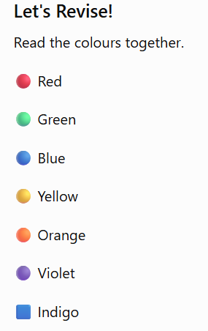
Primary English With Anisur Rahman
Revision
📚 English With Anisur Rahman | Learn English with Bangla Explanation

Slide 5
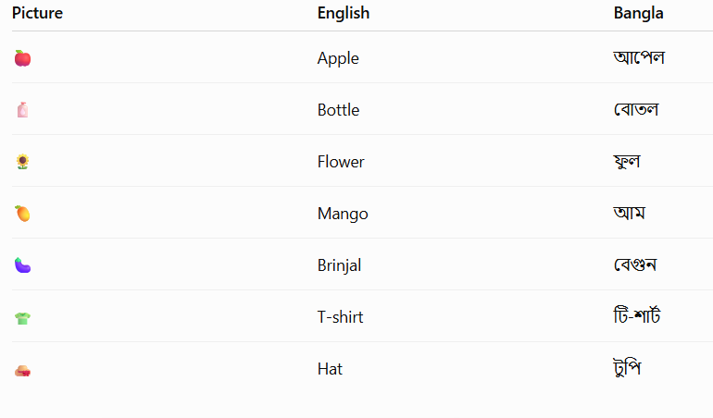
Primary English With Anisur Rahman
Vocabulary
📚 English With Anisur Rahman | Learn English with Bangla Explanation

Slide 6
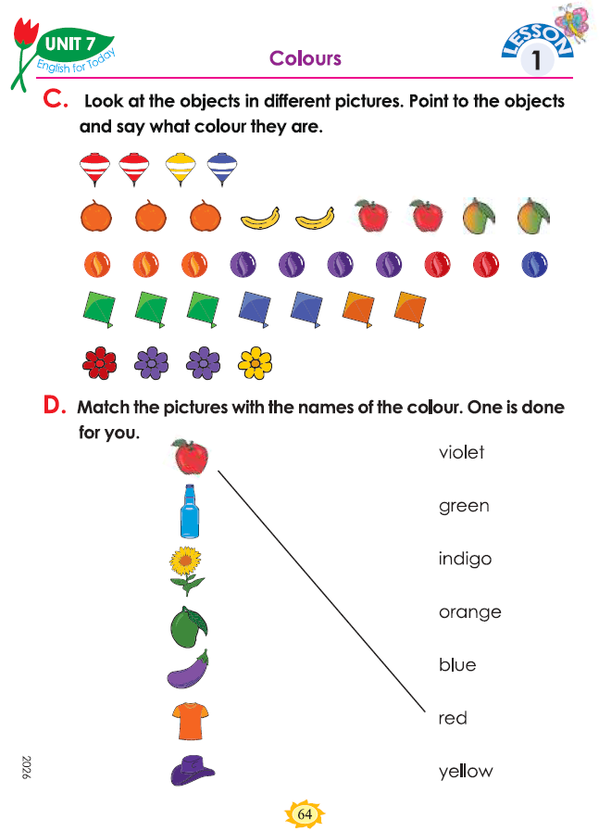
Primary English With Anisur Rahman
Activity C
The top is yellow.👉
The top is blue.👉
The top is red. 👉
The banana is yellow.👉
The apple is red. 👉
The mango is green.👉
The orange is orange. 👉
The marble is violet.👉
The marble is red. 👉
The marble is blue. 👉
The marble is orange.👉
The kite is indigo.👉
The kite is orange. 👉
The kite is green. 👉
The flower is yellow. 👉
The flower is violet.👉
The flower is red.👉
📚 English With Anisur Rahman | Learn English with Bangla Explanation

Slide 7
Primary English With Anisur Rahman
Activity D
📚 English With Anisur Rahman | Learn English with Bangla Explanation

Slide 8
Primary English With Anisur Rahman
Activity D
📚 English With Anisur Rahman | Learn English with Bangla Explanation

Slide 9
Primary English With Anisur Rahman
Pair Work
Ask and answer.
A: What colour is the apple?
B: It is red.
A: What colour is the bottle?
B: It is blue.
A: What colour is the flower?
B: It is yellow.
📚 English With Anisur Rahman | Learn English with Bangla Explanation

Slide 10
Primary English With Anisur Rahman
green
Practice
Fill in the blanks.
The apple is ______.
The bottle is ______.
The flower is ______.
The mango is ______.
The T-shirt is ______.
The hat is ______.
red
blue
yellow
green
orange
indigo
📚 English With Anisur Rahman | Learn English with Bangla Explanation

Slide 11
Primary English With Anisur Rahman
Quiz
What colour is the apple?
✅ Red.
What colour is the bottle?
✅ Blue.
What colour is the flower?
✅ Yellow.
What colour is the mango?
✅ Green.
What colour is the brinjal?
✅ Violet.
What colour is the hat?
✅ Indigo.
📚 English With Anisur Rahman | Learn English with Bangla Explanation

Slide 12
Primary English With Anisur Rahman
Assessment
📚 English With Anisur Rahman | Learn English with Bangla Explanation

Slide 13
Primary English With Anisur Rahman
Homework
Write these sentences.
The apple is red.
The bottle is blue.
The flower is yellow.
The mango is green.
The T-shirt is orange.
📚 English With Anisur Rahman | Learn English with Bangla Explanation

Slide 14
Primary English With Anisur Rahman
Thank You
Thank You
See you tomorrow.
📚 English With Anisur Rahman | Learn English with Bangla Explanation

