Slide 1


Slide 2
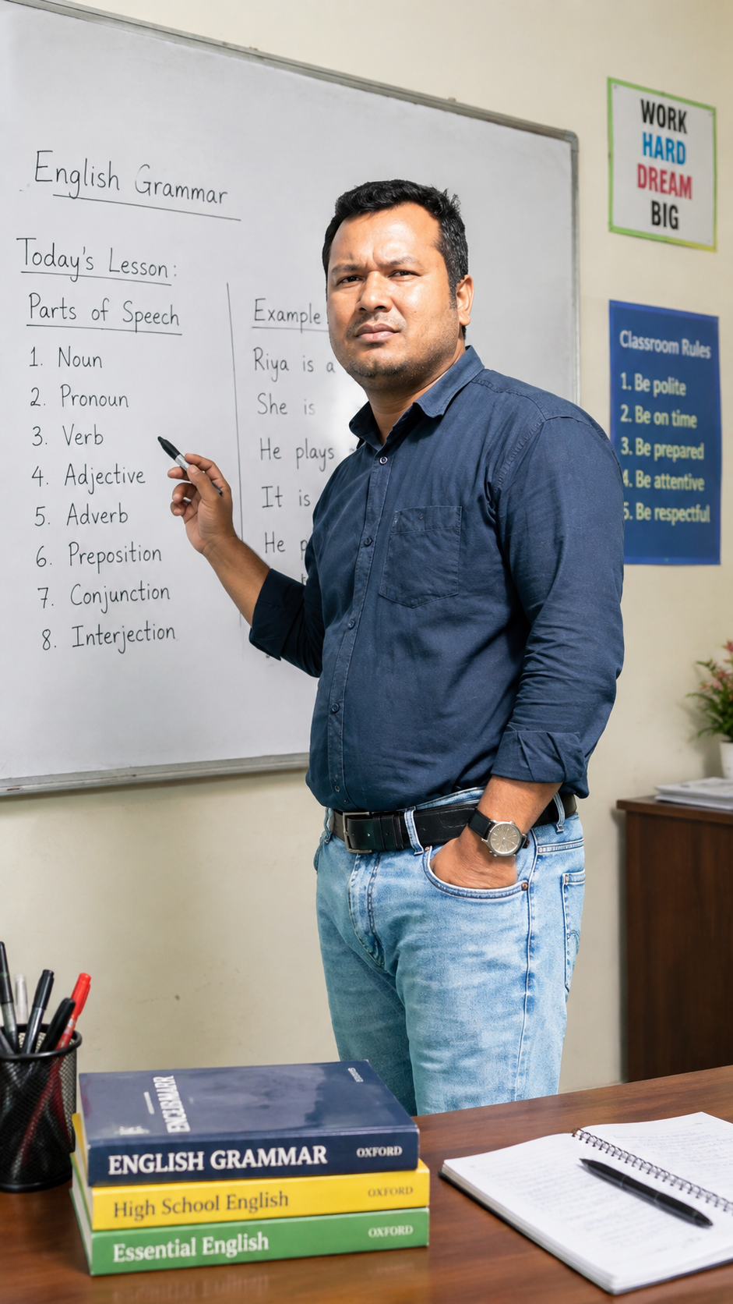
IDENTITY
Manik Sutradhar
Senior Teacher(English)
Prattasha Adarsha High School
01689177939

Slide 3

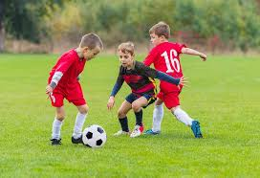
Tea is very hot, isn’t it?
Boys are playing, aren’t they?
Can you guess today’s topic?
YES, TAG QUESTIONS

Slide 4
What is a Tag Question?
A tag question is a short question
which is placed to the end of a statement.
Examples:
1. You are a student, aren’t you?
2. She likes music, doesn’t she?
3. They went home, didn’t they?

Slide 5
Positive statement → Negative tag
1. He is happy, isn’t he?
2. You can swim, can’t you?
Negative statement → Positive tag
1. He isn’t happy, is he?
2. You can’t swim, can you?

Slide 6
Use the same auxiliary verb in the tag.
1.She is beautiful, isn’t she?
2.They have finished, haven’t they?
3.He will come, won’t he?
4.You can drive, can’t you?

Slide 7
When There Is No Auxiliary Verb
Use do, does, or did.
1.You like tea, don’t you?
2.She plays tennis, doesn’t she?
3.They went there, didn’t they?

Slide 8
Special Cases
am → aren’t
I am late, aren’t I?
Let’s → shall we
Let’s go outside, shall we?
Imperative → will you
Open the door, will you?

Slide 9
More Examples
1.Rahim is a good boy, isn’t he?
2.You don’t like coffee, do you?
3.They have finished eating, haven’t they?
4.She didn’t come yesterday, did she?
5.We should help them, shouldn’t we?

Slide 10
Complete the tag questions:
1.She is a teacher, ______?
2.They don’t play football, ______?
3.You can speak English, ______?
4.He went to school, ______?
5.Let’s have some tea, ______?
Answers:
1.isn’t she?
2.do they?
3.can’t you?
4.didn’t he?
5.shall we?

Slide 11
Why Do We Use Tag Questions?
We use tag questions to:
1.Confirm information
2.Ask for agreement

Slide 12

Thank You

