Slide 1




Slide 2

TEACHER’S IDENTITY
Victor Bhuyan
Assistant teacher
Sonadiya cyclone Shelter Govt. Primary School.
Kabirhat, Noakhali.
Email:- victorbhuyan0@gmail.com

Slide 3

Today’s lesson is…
English for today
Class Two
Unit: 2
Lesson-6
(Words-k-o)
Page no. : 17
Time: 40 minutes

Slide 4

Learning outcomes
4.1.1 Read aloud simple words using the sound of letters and letters group.

Slide 5

Let’s listen to a song-
(abcd efg ijk lmnop qrst uvw xyz)

Slide 6
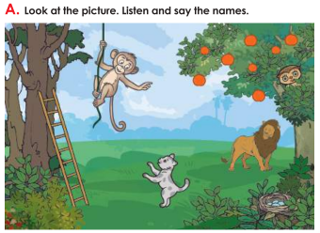
Look at thr picture.What can you see in the picture?
say the names
monkey
orange
Lion
ladder
kitten
nest

Slide 7

Today our lesson is…
Unit:- 2
Words (k-o)

Slide 8
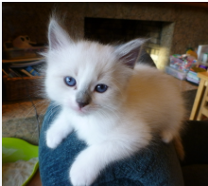

What can you see in the picture?
k
Kitten
K
l
Ladder
L

Slide 9
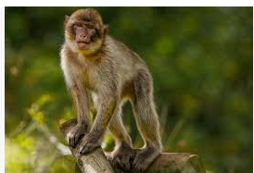
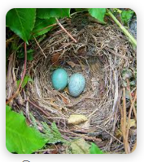
What can you see in the picture?
m
M
Monkey
n
N
Nest

Slide 10
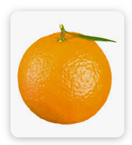
What can you see in the picture?
o
Orange
O

Slide 11
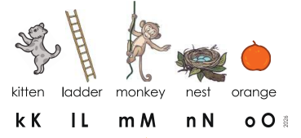
Look, Listen and repeat after me.

Slide 12
Group work
Now match the words with pictures…
monkey
orange
ladder
kitten
nest

Slide 13
Pairwork:
One of you will point to the pictures’ ‘kitten, ladder, monkey, nest, orange’, and the other will say the English word properly.

Slide 14

Homework
Write captital and small letters from Kk to Oo.

Slide 15
